Slide 1
UpX Academy – Walmart ML Project
Rajiv Ramanjani
March 2017 Batch : Submitted July 2017
Notes:
This template can be used as a starter file to give updates for project milestones.
Sections
Right-click on a slide to add sections. Sections can help to organize your slides or facilitate collaboration between multiple authors.
Notes
Use the Notes section for delivery notes or to provide additional details for the audience. View these notes in Presentation View during your presentation.
Keep in mind the font size (important for accessibility, visibility, videotaping, and online production)
Coordinated colors
Pay particular attention to the graphs, charts, and text boxes.
Consider that attendees will print in black and white or grayscale. Run a test print to make sure your colors work when printed in pure black and white and grayscale.
Graphics, tables, and graphs
Keep it simple: If possible, use consistent, non-distracting styles and colors.
Label all graphs and tables.

Slide 2
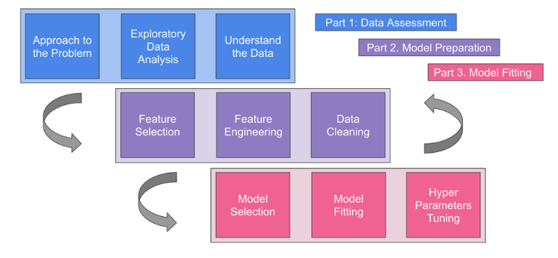
Project Flow Overview
Notes:
What is the project about?
Define the goal of this project
Is it similar to projects in the past or is it a new effort?
Define the scope of this project
Is it an independent project or is it related to other projects?
* Note that this slide is not necessary for weekly status meetings

Slide 3
Approach the Data
Four Datasets provided
Train
Test
Features
Stores
The Features and Stores datasets would be common datasets – whose data would be applicable to both the Train and the Test data.
Notes:
* If any of these issues caused a schedule delay or need to be discussed further, include details in next slide.

Slide 4
Exploratory Data Analysis
The training data was merged with the features dataset on the basis of ‘Store’, ‘Date’ and ‘IsHoliday’ columns. Later the output of this was merged again with the stores dataset. This was on the basis of ‘Store’ column. All duplicate columns are eliminated after that.
The same applied to the test data as well
This was required as the analysis of the training data revealed that the number of features was limited.
Notes:
Duplicate this slide as necessary if there is more than one issue.
This and related slides can be moved to the appendix or hidden if necessary.

Slide 5
Features
The merged datasets have the following features:
Store
Dept
Date
IsHoliday
Size
Unemployment
CPI
Temperature
Fuel_Price
MarkDown1, MarkDown2, MarkDown3, MarkDown4, MarkDown5
Type

Slide 6
Data Cleaning and Feature Engineering
After merging the data all null fields are reset to zero
The date field is changed to year and week of year combination.
The get_dummies function later makes the data fit for training
The merged training data is then split into a train data and a validation data. The last 400 records of the original merged training dataset is moved into a separate validation dataset.

Slide 7
Model Selection
Five different models are explored:
Random Forest Regressor
Gradient Boosting Regressor
Decision Tree Regressor
Linear Regression
Bayesian Linear Regression
The new training dataset is run through each of the above models
The Co-efficient of Determination if calculated for each of the models – to see which has the highest score.
Based on this it was seen that the Random Forest Regressor had the highest score
Notes:
The following slides show several examples of timelines using SmartArt graphics.
Include a timeline for the project, clearly marking milestones, important dates, and highlight where the project is now.

Slide 8
Model Fitting
The selected model is run against the validation dataset to see if the predicted Weekly_Sales label is close to the real Weekly_Sales figures.

Slide 9
Model Execution
Finally the merged test dataset is run through the model to make predictions on Weekly_Sales.
Insight:The Newark Liberty International Airport (EWR) has the highest arrival and departure delays – followed by John F Kennedy and then LaGuardia Airport

Slide 10
Overall Insights
The Department and Size of the Store matter a lot to the Weekly Sales. This is followed by Date, CPI, Unemployment, Temperature and Fuel Price. Type B stores seem to have more sales as compared to Type A or Type C stores. Also MarkDown 3 has the most impact on the sales as compared to other markdowns

Slide 11
Technical Approach
Modelling was initially done on Microsoft Azure Studio for ML
Once the suitable models were determined – it was later tried on Python Jupyter Notebook
Merging the datasets initially proved a challenge. Used Microsoft Power Query to work around this. But later achieved this on Python and Azure
On Azure – was able to create an excel plugin to create the predictions

Slide 12
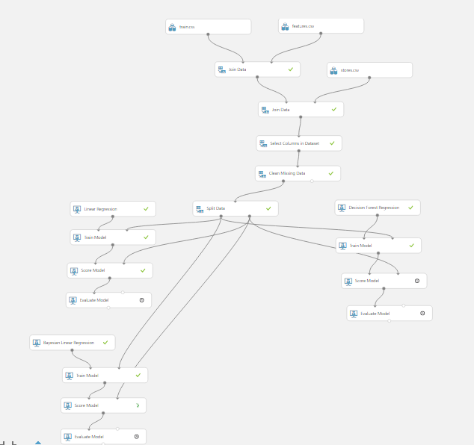
Azure Flow

Slide 13
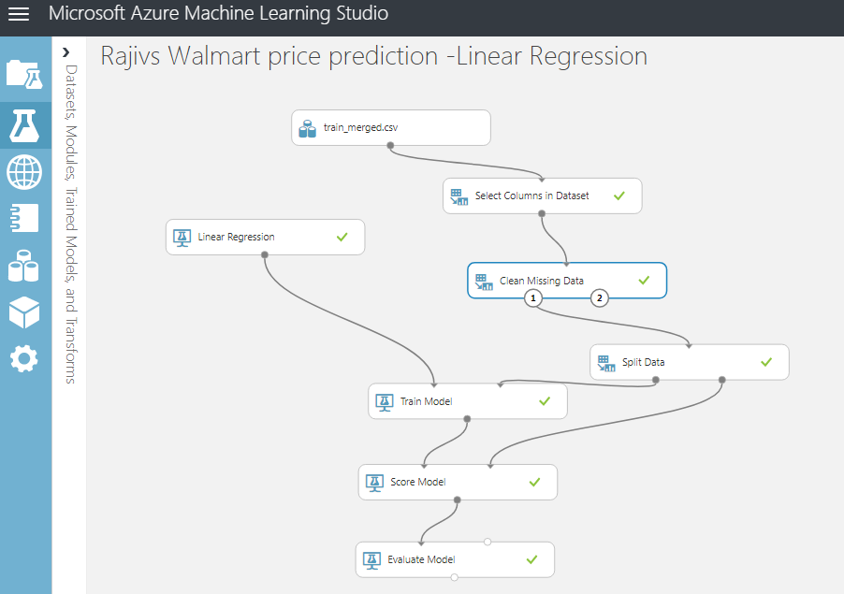
Azure – Linear Regression : WorkFlow

Slide 14
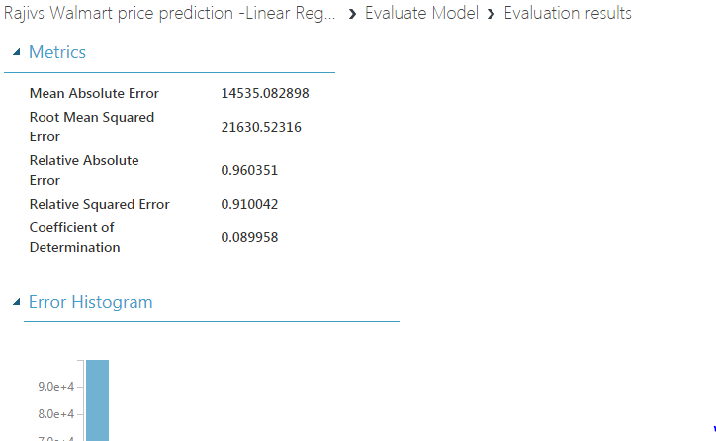

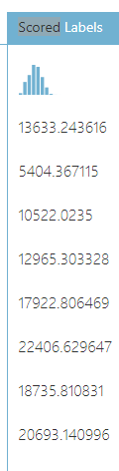
Azure – Linear Regression : Scores

Slide 15
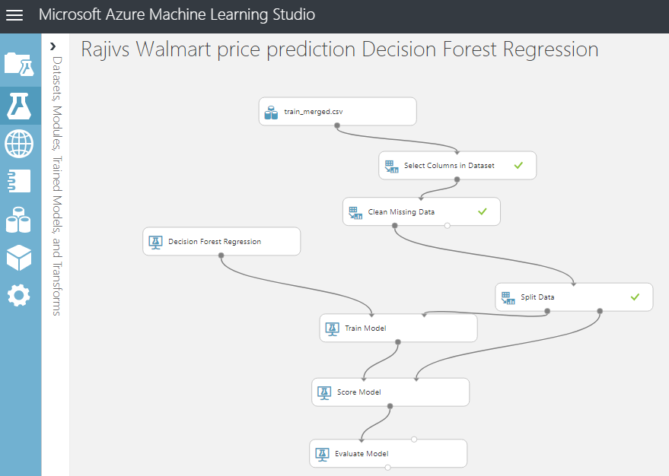
Azure – Decision Tree Regression

Slide 16
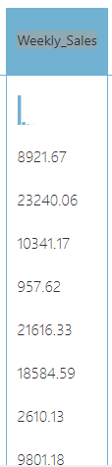
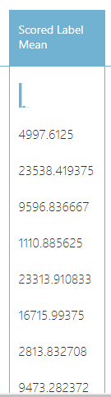
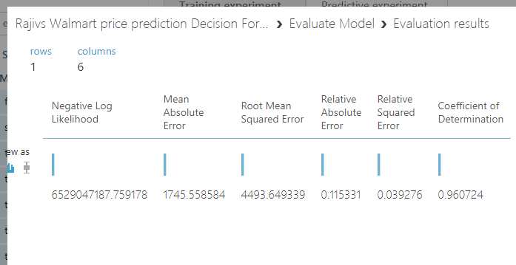
Azure – Decision Tree Regression :Results

Slide 17
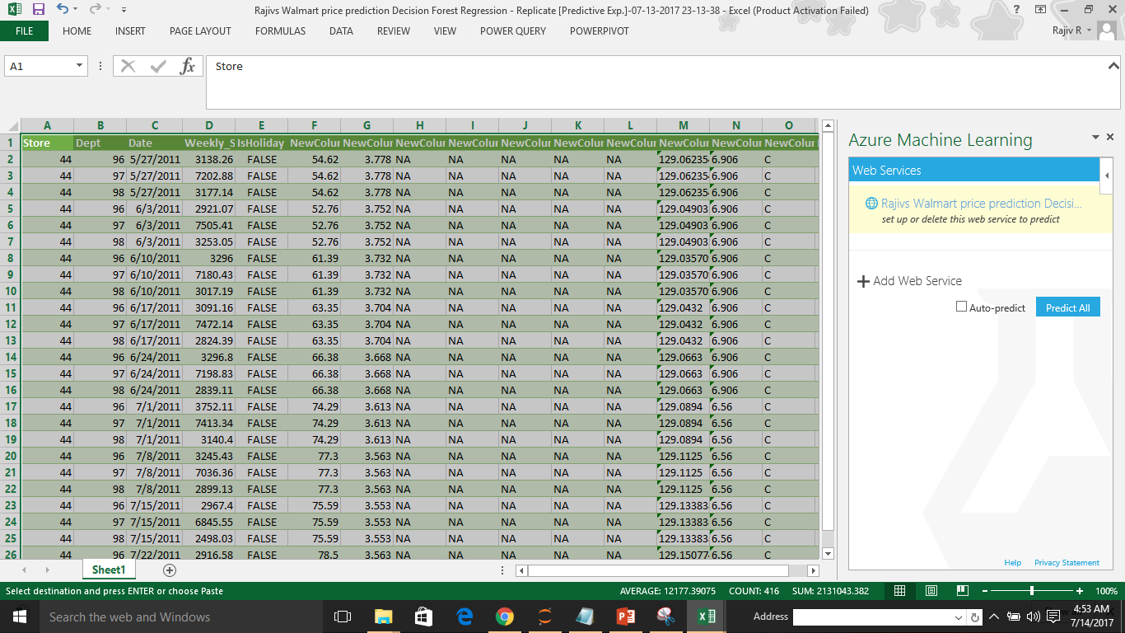
Azure – Excel predictions

Slide 18
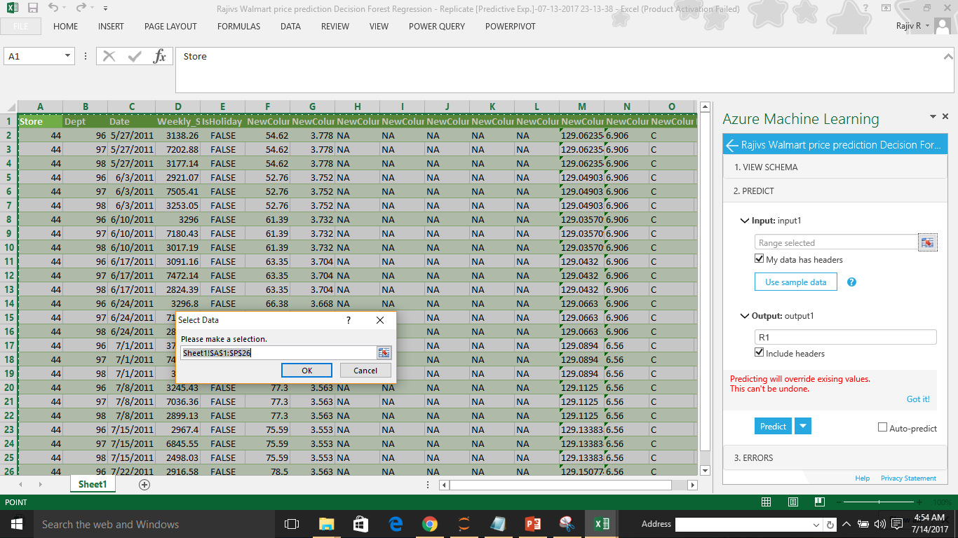

Slide 19
Azure – Web Tool for Walmart predictions
https://services.azureml.net/workspaces/1afe46498a764713bcd9632c5e846e22/webservices/9d322e8f96854921ba49a17bcedeb9d2/endpoints/default/test/rrs?fromStudio=true

